Slide 1
Safe Indoor Air for Commercial Application
AIRBOX | EDUCATION
Does your facility have acceptable indoor air quality? AirBox is the most effective and cost efficient solution to mitigate the risk of airborne pathogens.

Slide 2
Indoor Air Quality (IAQ) – Why AirBox?
Our buildings are poorly ventilated (90% of our time is spent indoors)
Must address the air beyond the pandemic – proactive mindset vs. reactive mindset – become pathogen hardened, prevent future closures
Respiratory aerosols linger for hours in poorly ventilated buildings – AirBox creates the dynamic airflow needed to dilute, displace and remove the airborne pathogens from the Breathing Zone
Many contaminants in the air have long term effects on our health – allergies, asthma, respiratory illness, cancer, etc…
The cleaner the air, the better the brain functions. It is proven that cleaner air improves productivity in the workforce, improves the ability for students to learn – and it cuts down on days missed t due to sickness and health issues
AirBox addresses pathogen mitigation at the highest level and provides the cleanest air possible and healthiest environment – Safe Air Plan based on proven technology and an engineered solution built to last a lifetime

Slide 3
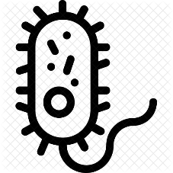
AirBox Safe Air Plan helps protect from:
VOCs
Viruses
Fungi
Odors
Bacteria
Mold
VOCs
Dust
Pet Dander
Chemicals

Slide 4
What is HEPA Filtration? – Proven Technology to Remove all pathogens regardless of composition
High-Efficiency Particulate Air (HEPA) is an efficiency standard of air filters developed by the U.S. Department of Energy
HEPA air filter must remove—from the air that passes through—at least 99.97% of particles whose diameter is equal to 0.3 μm; with the filtration efficiency increasing for particle diameters both less than and greater than 0.3 μm
How do we know it works?
It has been around since 1940’s – designed to remove nuclear particles and keep scientists safe
Used in BSL3/4 Bio-aerosol labs – keep researchers safe
Used in Airborne Infectious Isolation Rooms (AII) – Keep hospital staff and patients safe
Used in semiconductor – manufacturing of microchips
Used in cleanroom application – pharma, life sciences

Slide 5
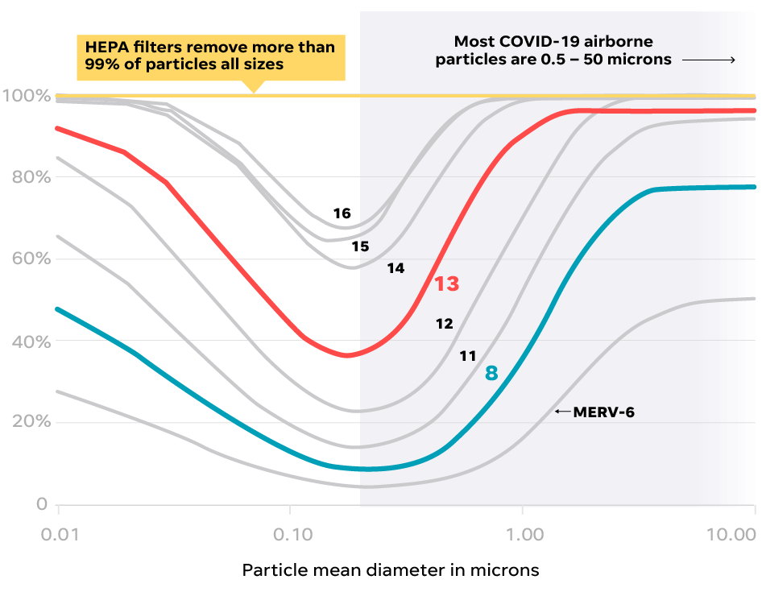
Filtration Efficiency – MERV 13 vs. HEPA
Most SARS-coV-2 airborne particles range are .06 - .14 Microns

Slide 6
Expectations of an Air Purifier - Pathogen Mitigation
Any Air Purifier Considered for use in American Institutions for purposes of pathogen mitigation must conform to established US Standards. This includes:
FDA Compliance
EPA Registration
Institute of Environmental Science and Technology (IEST) Certifications
UL Listed
As well as Guidelines established by ASHRAE, CDC and OSHA for Engineering Controls:
Increase outdoor air ventilation
Increase total airflow supply to occupied spaces, when possible
Improve Filtration Efficiency
Use portable high-efficiency particulate air (HEPA) fan/filtration systems to help enhance air cleaning

Slide 7
Conversion of guidance to a clear, concise and measurable plan
AirBox’ position is that our plan is not only about the pandemic response but moreover it is about setting a standard for Indoor Air Quality based on respiratory aerosol abatement that provides a safe, hygienic environment for occupants. Our plan will meet or exceed eventual requirements that evolve from any of these administrative authorities (ASHRAE, OSHA, CDC, FDA, EPA)
AirBox 4 pillars
AirBox CFD modeling suggest control of the airflow dynamics within the room is the most effective means of mitigating cross contamination of respiratory aerosols in proximity
(Long term) Installation of Air Purifiers in each return air duct completely eliminates respiratory aerosol migration within multiple rooms. Installing portable air purifiers in the room is the most effective and cost efficient mitigation plan (short term)
Use of CO2 as a proxy for RA’s allows low cost efficient monitoring of safe of levels of RA’s. Setting alert/investigation at 1000 PPM and alarm/evacuate at 2000 PPM
Antimicrobial treated filters are effective in neutralizing COVID-19 given it has a membrane “cell” wall
*eliminate Plexiglass partitions, balancing to existing ASHRAE standards and the use of portable dynamic air purifiers can minimize horizontal airflow patterns in the Breathing Zone

Slide 8
How Can AIRBOX Help?
AIRBOX takes the square footage and occupancy of each facility into consideration to offer hospitals and healthcare facilities a Safe Air plan tailored to their specific needs.
Each HEPA filter is certified – meets conformance & standards set forth by FDA/ASHRAE/OSHA/IEST Standards
Removes >99.99% of all particles, including dangerous pathogens, from breathing air

Slide 9
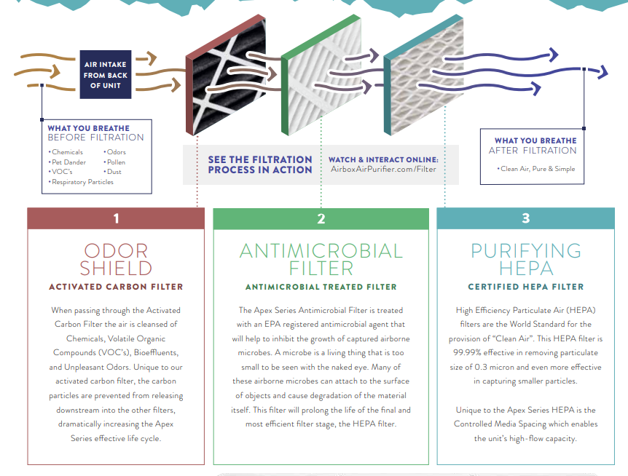
Filters
Both the Apex and Peak Series use two pre-filters before the HEPA filter to ensure all particles regardless of composition are being effectively captured and to increase longevity of the HEPA Filter.

Slide 10
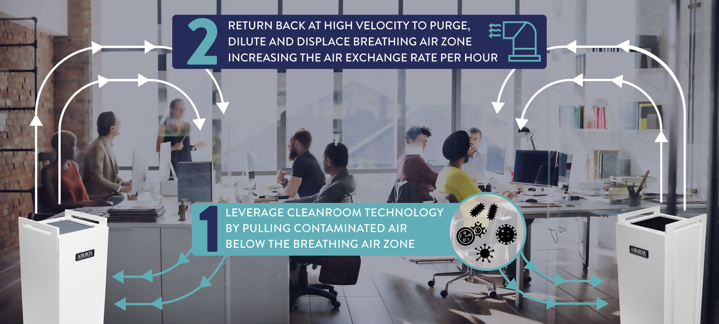
Dynamic Room Purge Technology

Slide 11
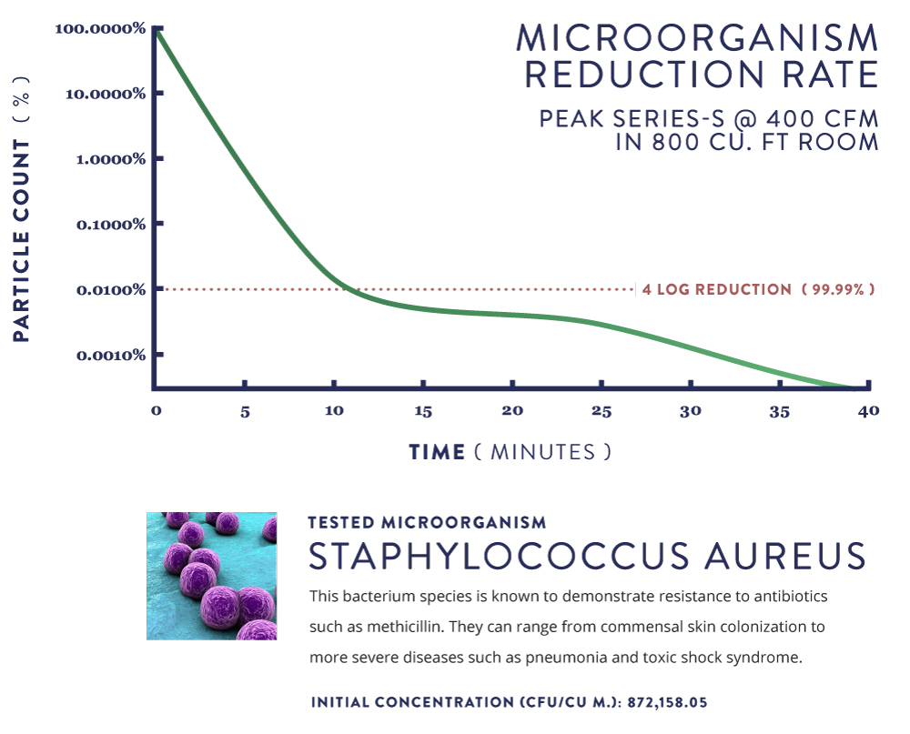
Microorganism Reduction Rate

Slide 12
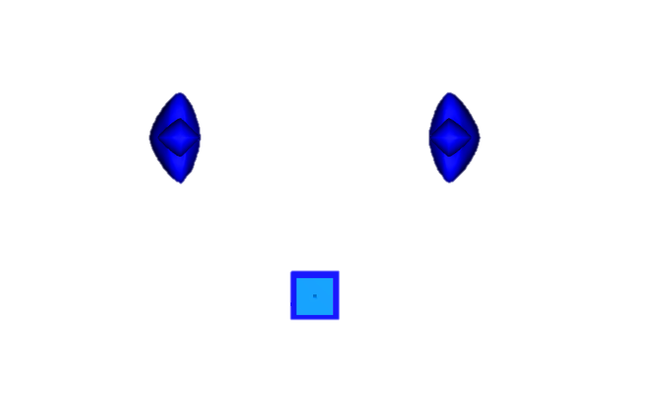
CFD Modeling
6’
3’
PEAK: OFF
PEAK: 200 CFM, 90 DEGREES
PEAK: 200 CFM, 45 DEGREES

Slide 13
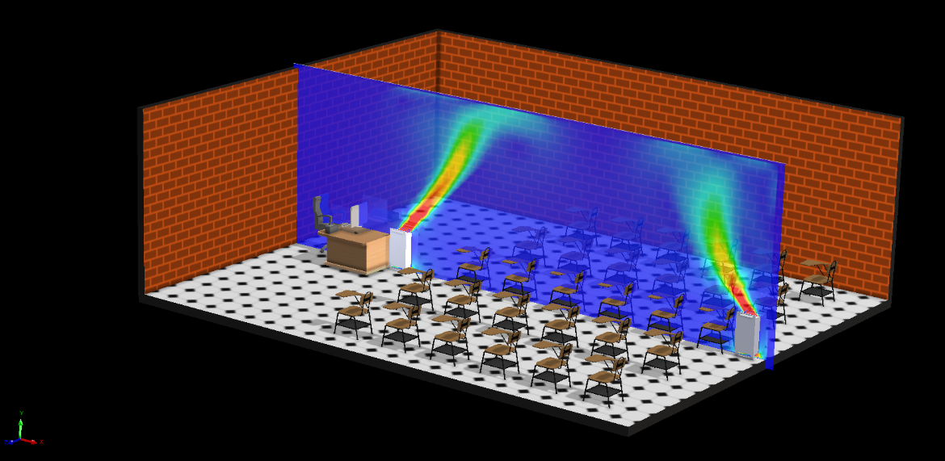
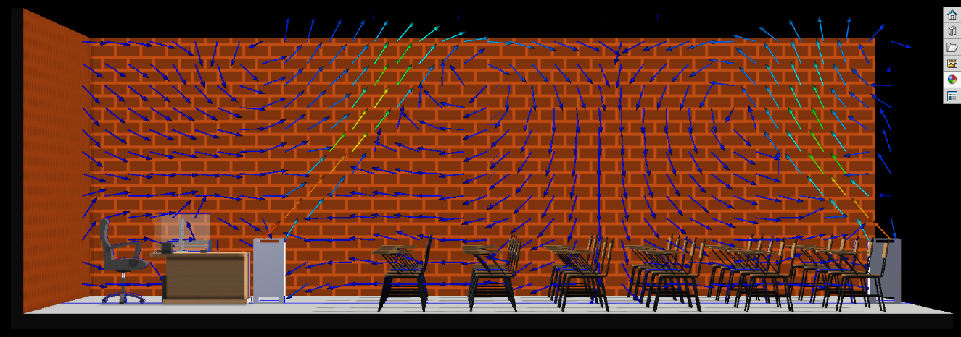
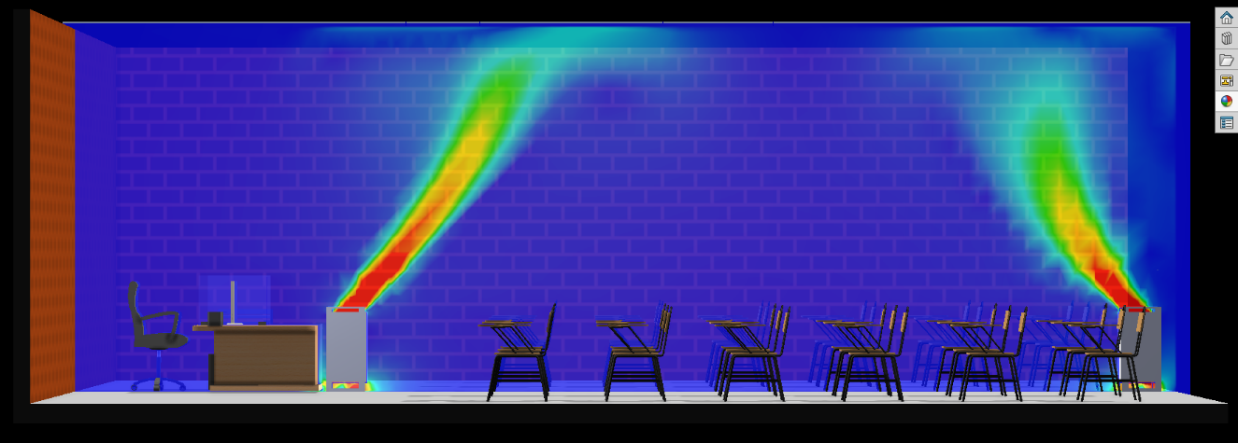
CFD Modeling Real Life Applications

Slide 14
Target Markets – Budd Group Clients
Schools – 190 billion dollars (3 stimulus packages) – air purification, ventilation, HVAC improvements
Colleges – Athletic Facilities, Cafeterias, Student Centers, Large Gatherings
Government Building – 350 billion for state, city and local
Commercial Office Space – cubicle environment
Pharmaceutical – Cleanroom industry aware of HEPA – perfect application for their office environment
Industrial Mfg – Apex 2.0
Medical Facilities, Automotive, Nascar (owners’ suites), Churches, Food Production, Food Production

Slide 15
Alternative/Supplemental Products
Ionization
There is no convincing scientifically-rigorous peer-reviewed studies on Needlepoint Bipolar Ionization (NPBI). ASHRAE does not take an official stance outside of recommending caution as systems range from ineffective to very effective. (Buyer beware). They defer to the CDC for their stance which concludes there is an absence of a body of evidence reflecting proven efficacy under as-used conditions. They encourage user to exercise caution and do your homework.
This has only been tested by exposing a petri-dish in a single cubic foot environmental chamber (ShoeBox) with a low concentration of pathogens. Testing does not translate to real life environment. It is considered an emerging technology, unproven in a real world application.
Key Notes
Some units produce by-products such as ozone, acetone, formaldehyde, etc…
Currently, class-action lawsuit against the largest manufacturer (Global Plasma Solutions)
Many Scientists, Researchers and IAQ Experts are speaking out against this technology – Schools are being called out for spending federal dollars on a potential harmful solution
Many HVAC Contractors recommend this solution and have partnered with Ionization companies – trusted partners of schools, government, and businesses
Cheap to install, out of sight out of mind, check the box mentality
Ozone producing ionizers are banned in CA

Slide 16
Alternative/Supplemental Products
UV-C
Many HVAC companies suggest to install UV-C sticks in the air handler. These are simply keeping the cooling coils free from mold and bacteria.
UV is proven technology for surface contaminants but is not as efficient as HEPA in regards to airborne pathogens.
Upper room UV must be installed correctly to be effective and can create ozone which is harmful to our health. (throughout the entire air handler)
UV-C is ineffective in the shadows
Key Notes
Easy to install (air handler)
Check the box mentality
Out of sight (marketing signs, advertisement of installation)
UV-C in an air purifier application is a waste of energy and serves no purpose outside of inhibiting growth of microbes on HEPA filter. (can damage filter and do more harm)
This is a supplemental solution.

Slide 17
Alternative/Supplemental Products
MERV-13 – Higher rated installed HVAC Filter
This is a compromise to HEPA, in many cases the highest capacity filter most HVAC systems can handle without creating too much static pressure.
It can be a good element of a more comprehensive mitigation solution. However, it can also jeopardize the Air Handler and create more humidity and poorer ventilation due to the capacity of current HVAC systems.
The efficiency of MERV-13 filters is 80% at particles size 1 micron and higher, it is ineffective at smaller particles.
This does not address the removal of airborne pathogens in the breathing zone.
Key Notes
AirBox targets the breathing zone to displace, dilute and remove the pathogens so they do not linger for hours and increase the risk of infection.
If AirBox can provide HEPA filtration at 99.99% or higher of all particle sizes down to 0.01 micron, in an affordable manor, it is the absolute best mitigation plan possible outside of a cleanroom environment.
HEPA is proven technology to mitigate the spread of airborne pathogens regardless of composition.
Moving to MERV-13 in a commercial environment is recommended by CDC, OSHA and ASHRAE.

Slide 18
Features
It All Starts Here.
Design
Peak-S model - High-Density Polyethylene treated with Antimicrobial
Apex – Polished/brushed aluminum & stainless steel fasteners
Technology
Built to run 24/7, true engineered solution using the same dynamic room purge technology as seen in clean rooms
Warranty
Lifetime warranty on materials and craftsmanship, 5 year warranty on fan/motors

Slide 19
Apex Series
Clean Air. Pure & Simple.
State-of-the-art Air Flow & Filtration, The Apex Unit is a one-of-a-kind industrial-grade air purifier with the power to clean the constant expulsion of particles into our air in larger commercial spaces, especially high-traffic locations. Like the name suggests, the Apex Series is the pinnacle of clean air technology. Integrated with the same technology as many high-profile, high-tech clean rooms in the country.
Fan Speed Settings | Space Purified Per Minute
720
800
880
Low
Med
Hi
Cubic Ft./min.
Cubic Ft./min.
Cubic Ft./min.

Slide 20
Peak-S Series
Clean Air for Life.
Providing over 25,500
Cubic feet per hour of Antimicrobial,
Chemical, and HEPA Filtration, it
measures a mere 13½” x 13” x 27¾” in size
Fan Speed Settings | Space Purified Per Minute
100
275
425
Low
Med
Hi
Cubic Ft./min.
Cubic Ft./min.
Cubic Ft./min.
Serving home, medical, educational, and industrial
applications, the AirBox Peak Series-S is
categorically the most effective and efficient
Air Purifier on the market. Like the name
suggests, the Series-S is made of the highest
quality materials

Slide 21
Mesa Series
Clean Air for Life.
Providing over 22,500
Cubic feet per hour of Antimicrobial and HEPA Filtration, it
measures a mere 18” tall and weighs 31 pounds
Fan Speed Settings | Space Purified Per Minute
75
250
375
Low
Med
Hi
Cubic Ft./min.
Cubic Ft./min.
Cubic Ft./min.
Perfect for executive and administrative offices, small classrooms, doctors office – exam room, residential homes.

Slide 22
Repopulating American Businesses
The Right Way
Visit our website airboxairpurifier.com or contact us by calling (855) 927-1386 or emailing info@airboxairpurifier.com to learn more about creating a customized Safe Air Plan for your school.
AIRBOX is regulated by the US Environmental Protection Agency and state governments as a pesticidal device. Accordingly, our air purifiers are produced in an EPA-registered facility and packaged and labeled in accordance with EPA regulations under FIFRA section 2(q)(1) and 40 CFR Part 156.

